Slide 1

DataFrame Manipulation Methods

Slide 2
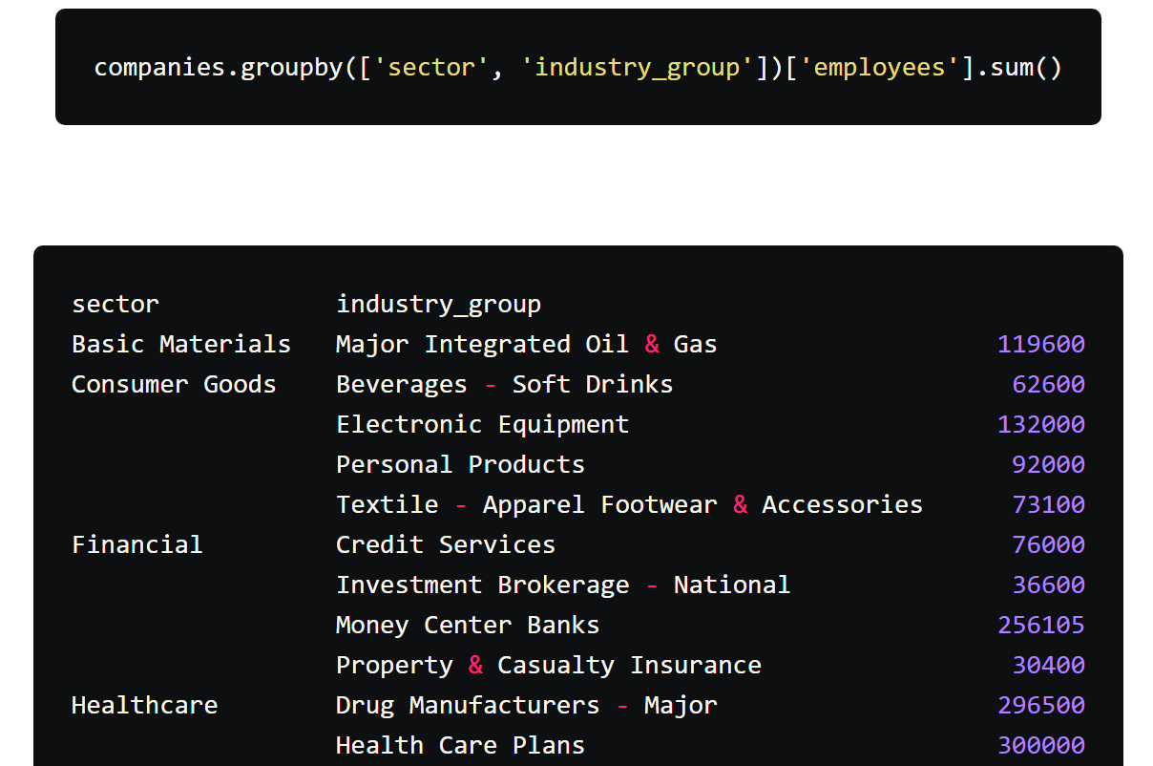
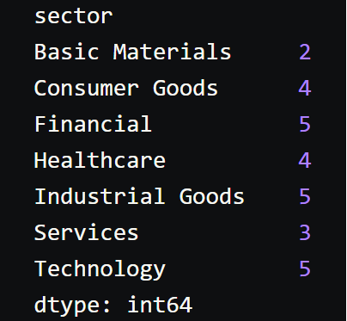
Pandas
Grouping and Aggregating Data
groupby()
sum(), mean(), max(), min(), count(), etc.
size() – to get size of each group Ex: print(sector_group.size()) in this case gives total no of companies in each sector

Slide 3
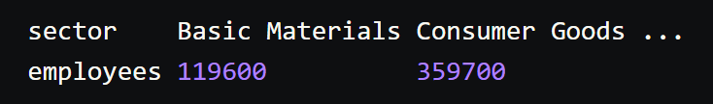
Pandas
Reshaping
df.pivot()
pd.concat()
df.sort_values()
df.rename()
df.drop()/df.drop_duplicates()

Slide 4
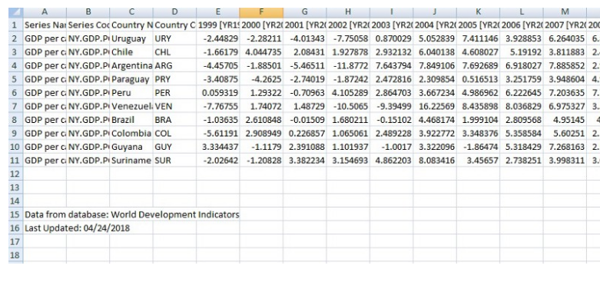
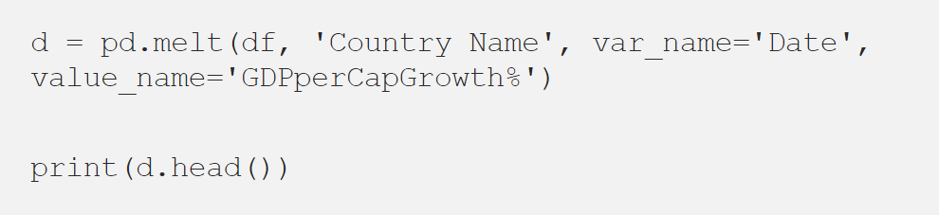
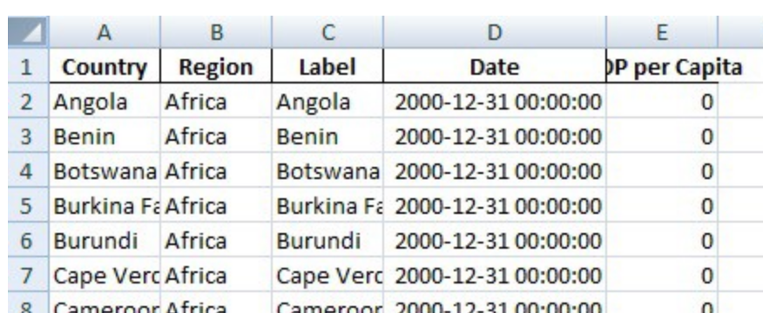
Pandas
Reshaping contd..
pd.melt()

Slide 5
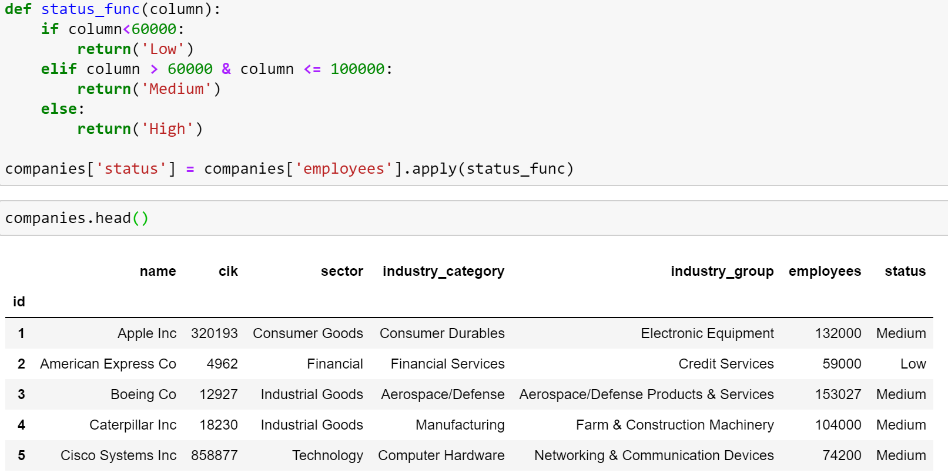
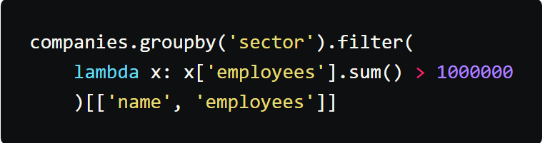
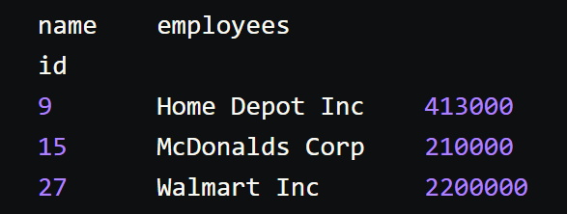
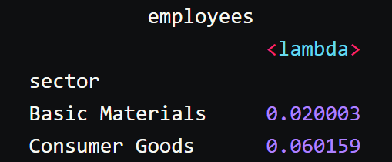
Pandas
Transformation/Filtering
apply()
transform()
df.filter()

Slide 6
Pandas
Merging Data
pd.merge()

